Slide 1

MCA Major Project Mid Term Evaluation
PayBuddy
Under the guidance of
Dr. Monika Vishwakarma
Department of Computer Applications
Faculty of Science, Technology and Architecture
Manipal University Jaipur
By
Kuldeep Singh
23FS20MCA00076
2023-25

Slide 2
Outline
Introduction
Motivation
Process Model
Software Requirement Specification (SRS)
Data Flow Diagram (DFD)
Output
Conclusion
Future Scope

Slide 3
Introduction
PayBuddy is your trusted partner for fast, secure, and convenient digital transactions. Whether you’re paying bills, transferring money, or shopping online, we make it simple and safe to manage your finances with ease. With a focus on security and user-friendly design, PayBuddy ensures a smooth and hassle-free experience for all your payment needs.
The importance of digital transactions continues to grow, making financial services more accessible, efficient, and secure for people around the world.

Slide 4
Motivation
Traditional payment methods are time-consuming, insecure, and often inaccessible so theres a especially in underserved areas. Users struggle with complex online payment systems, high fees, and a lack of real-time transaction tracking. There is a need for a secure, simple, and convenient platform that offers seamless digital transactions for everyone, anytime, and anywhere:
Challenges in Existing cash management.
Difficulty in security and accountablity.
Need for a Dedicated platform.
How Paybuddy Will Improve This?
Digital transactions make managing money easier, faster, and safer. They allow instant payments, reduce costs, and help keep track of your finances. They also make it easier to access financial services globally, promote equal access to money for everyone, and help the environment by cutting down on paper. Overall, digital transactions simplify how we handle money and create a more efficient, secure, and fair financial system.

Slide 5
Process Model
Paybuddy is a Agile or iterative software process model, the model breaks down process into smaller manageable cycles called iterations where each cycle involves planning ,design, development and testing with feedback.
Building a prototype, getting a feedback and then refining it based on the feedback
User Registration & Authentication: User input, security , email verification.
Profile Setup & Bank Linking: User profile completion, linking payment methods , KYC(know your customer)
Transaction Initiation: Select transaction type, enter transaction details transaction summary.
Transaction Authorization & Security Check: Security verification , User approval.
Transaction Processing: Payment gateway integration, fund deduction, confirmation.
Transaction Completion: Receipt generation, user notification, transaction history update.
Customer Support Continuous Improvement & Monitoring: Issue and report handling and refund, updates and user feedback.

Slide 6
Software Requirement Specification (SRS)
1. Functional Requirements
User Authentication: Secure login and registration.
Profile Management: Users will update personal details and link their bank account.
Money Transfer:Users can initiate money transfers to other users or external bank accounts.
Bill Payment:Users can pay for utilities (electricity, water, gas), mobile recharges, and other services
Transaction History:Users can view a detailed history of their transactions, including date, time, amount
Customer Support:Users will have access to customer support via email or chat.
Security Features:Two factor authorization and data encryption.
Payment Gateway Integration:he system will integrate with external payment gateways to process payments securely.

Slide 7
2.Non functional:
Performance:The system should support at least 10,000 simultaneous transactions with minimal delay.
Security:Data Encryption,User Authentication
Availablity:The system should have 99.9% uptime, with minimal downtime for maintenance.
Scalablity:The system should be able to scale to handle increased user traffic and transaction volume without degrading performance.
Usablity:The platform should have an intuitive and easy-to-use interface, accessible via both web browsers and mobile devices.
Compliance:PayBuddy must comply with financial regulations, including PCI-DSS for card payments and KYC for user identity verification.
3.System Features:
Frontend:A responsive web application that allows users to interact with the system
Backend:A secure server-side application using technologies like Node.js
Database: Database like mongodb sql to store and update data.
Payment gateway:Integration with external payment services like Razorpay, Paytm, or Stripe to facilitate payment processing.

Slide 8
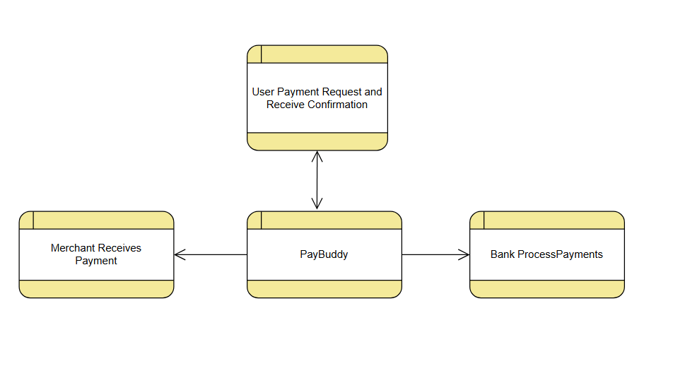
Data Flow Diagram
Level 0 DFD

Slide 9
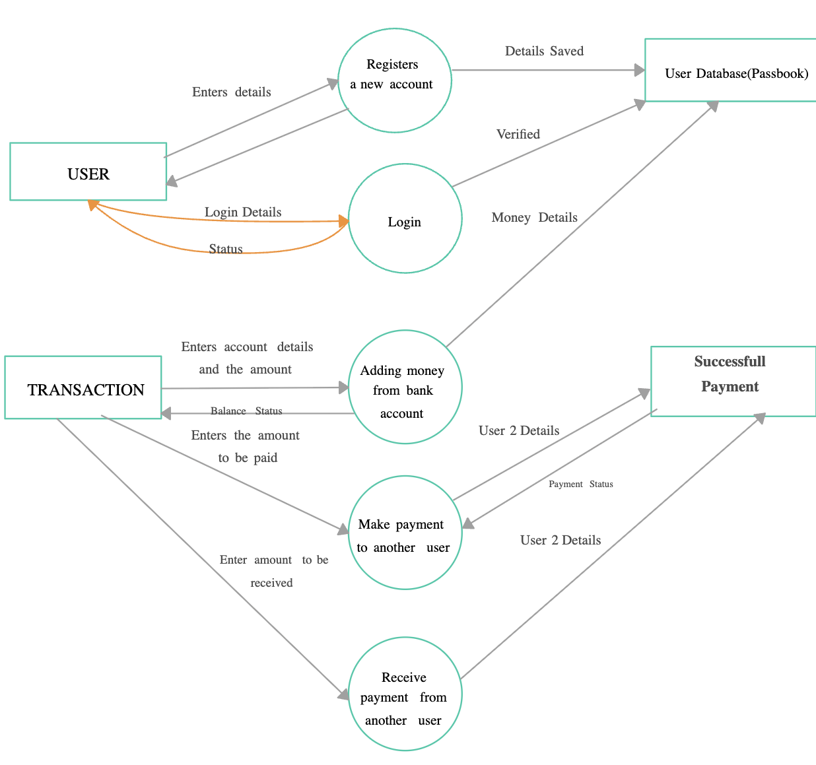
Level 1 DFD

Slide 10
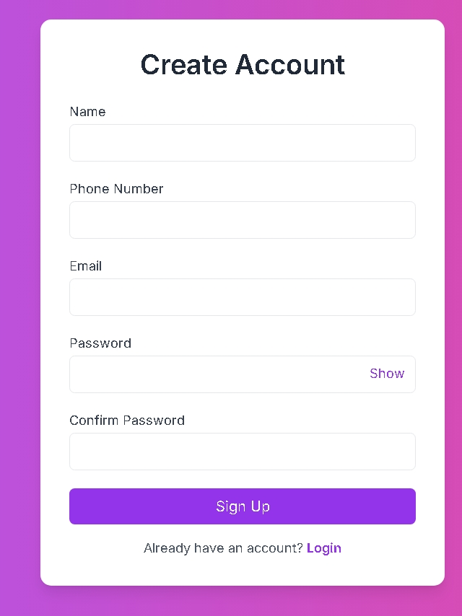
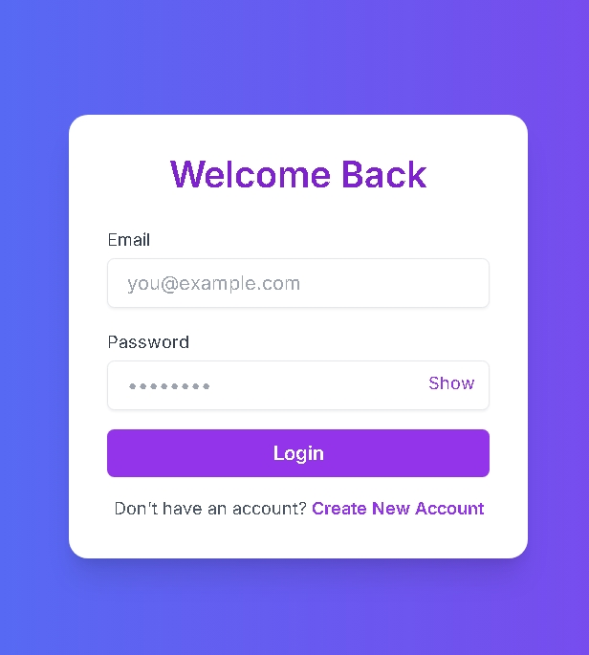
Output:

Slide 11
Output:
Sign-up Component: New users through signup component can register and the data will be stored in mongodb database.
FirstName: User enters first name in the bar.
LastName: User can enter last name.
Email: User enter the email.
Password: User can create password as per the norms, which should be strong password.
SignUpButton: After completing all the process one can sign-up.
Sign-in Component:
Email: Users can enter the registered email from the sign-up component.
Password: Users can enter the registered password.
Sign-In: the button signs the user into the dashboard page of paybuddy.

Slide 12
Conclusion
PayBuddy is a simple, secure, and convenient platform that makes digital transactions easy for everyone. Whether it's paying bills, transferring money, or shopping online, PayBuddy ensures that all your financial needs are met quickly and safely. With a focus on security, user-friendliness, and constant improvements, PayBuddy is set to grow and adapt to the ever-changing digital world. As more people move towards cashless payments, PayBuddy will continue to be a reliable tool.
Key Features:
Fast Transactions: Instantly send and receive money with real-time payment processing.
Secure Payments: Advanced encryption and two-factor authentication for safe transactions.
User-Friendly Interface: Simple and easy-to-use design for seamless navigation.
Money Transfer: Send money to friends, family, or businesses quickly and securely.
Payment History: Track and manage your transactions with detailed records.
Multiple Payment Methods: Link and use debit/credit cards, bank accounts, and e-wallets
Financial Inclusion: Accessible to users without traditional banking accounts.

Slide 13
Future Scope
The future of PayBuddy in the world of digital transactions looks exciting, with many opportunities for growth and improvement.
Key Features
Wider User Base: As more people in India and around the world get access to smartphones and the internet, PayBuddy will become a go-to platform for digital payments, allowing people to easily manage their finances anytime, anywhere.
Faster Transactions: PayBuddy will continue to improve its speed, making transactions instant and seamless.
Stronger Security: With growing concerns about online fraud, PayBuddy will invest in advanced security features like fingerprint or face recognition, AI-powered fraud detection, and end-to-end encryption. \
Integration with More Services: In the future, PayBuddy will integrate with more services, like paying for groceries, transportation, and utilities.
Cryptocurrency Support: PayBuddy may introduce the ability to send and receive cryptocurrencies like Bitcoin
Global Payments: PayBuddy will allow users to send money internationally
User Experience & Innovation: PayBuddy will continue to evolve with a focus on user-friendly features and innovations.

